Slide 1
Adam Taliaferro Story
Wilkes University and Luzerne County Medical Society
2023 Pain & Addiction Summit
April 28, 2023

Slide 2
Everybody has a story!

Slide 3
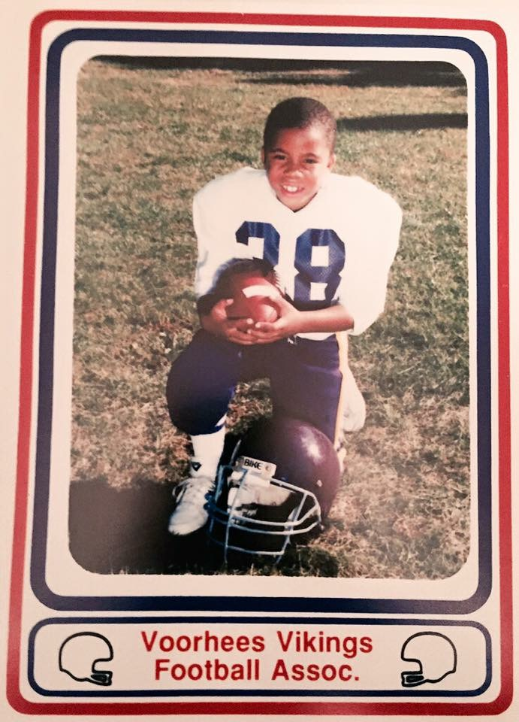
My Story

Slide 4
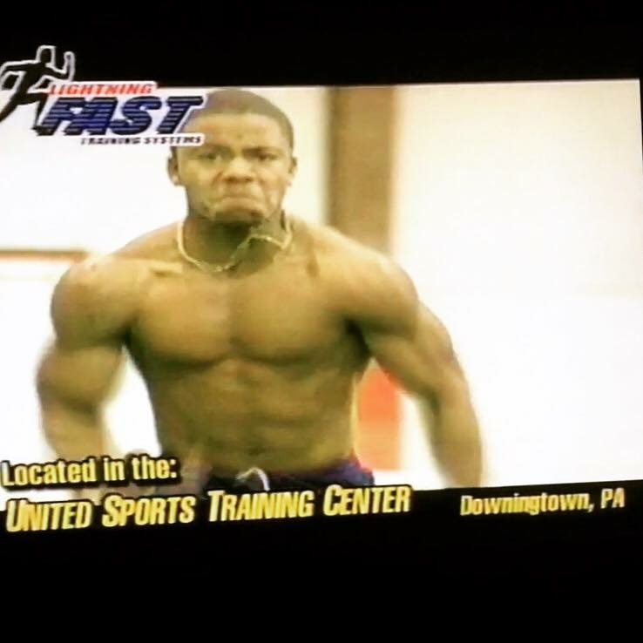
High School

Slide 5
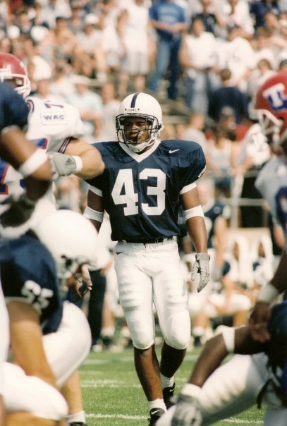
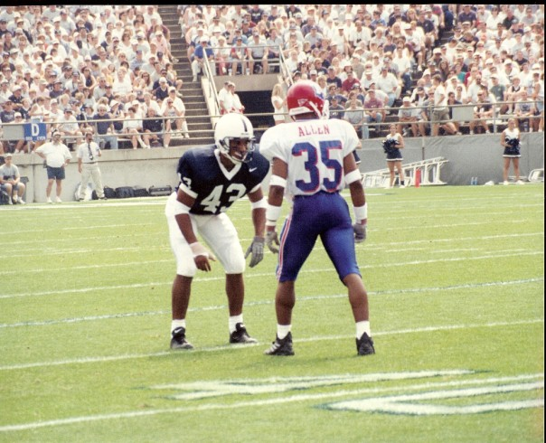
College

Slide 6
The Injury

Slide 7
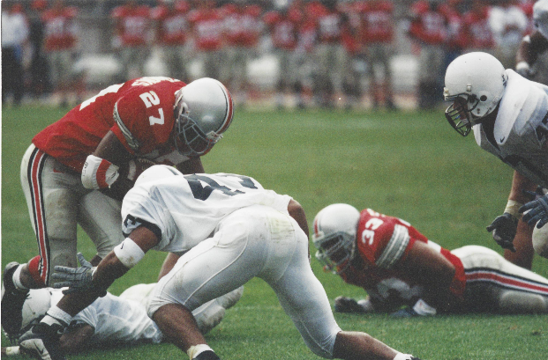
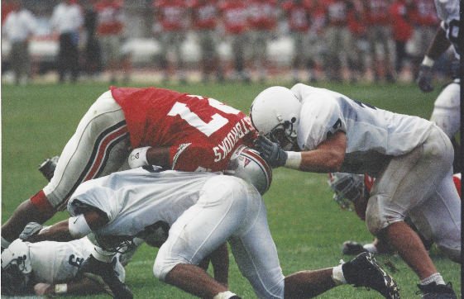
The Injury

Slide 8
Surgery

Slide 9
Road to Recovery

Slide 10
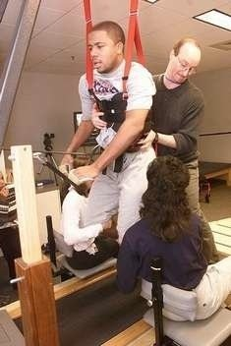
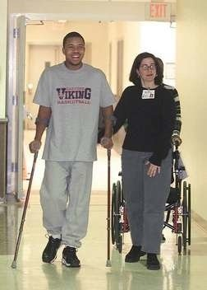
The Rehab

Slide 11
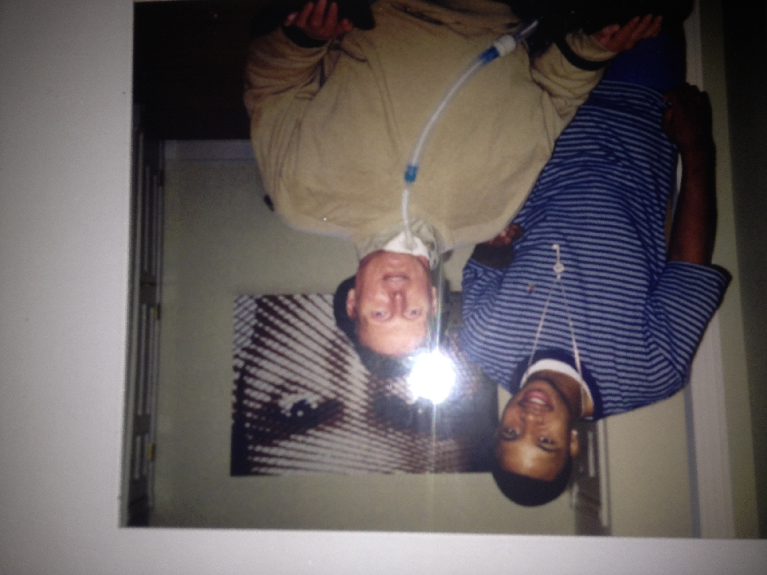
The Rehab

Slide 12
Return to Penn State

Slide 13
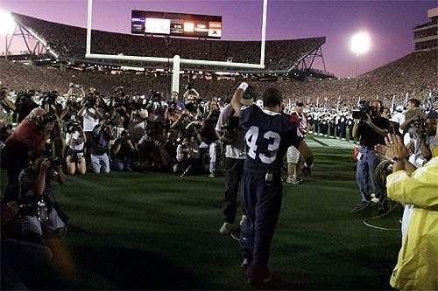
The Return

Slide 14
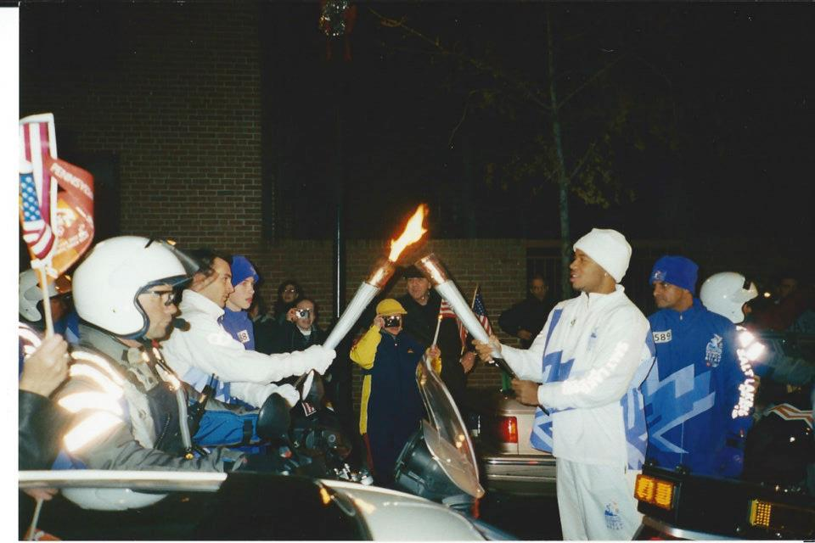
2002 Winter Olympics

Slide 15
The Book

Slide 16
We All Have a Story!

