Slide 1
Sublocade for the Treatment of Opioid Dependence
Donna Eget, DO

Slide 2
Manufactured by Indivior
Chemical name is buprenorphine
Notes:
Made in the USA, Virginia

Slide 3
What is Sublocade?
Buprenorphine extended Release Injection
-partial agonist
-limited power
-no naloxone
Notes:
WHAT is Sublocade ?
All buprenorphine (Sublocade, Suboxone, Subutex) has similar properties
Will only partially activate the receptor
Limited amount of NT released
No NALAXONE which acts as a deterrent to abuse and may help with cravings

Slide 5
How do you choose MAT?
Methadone
Naltrexone
Buprenorphine Products

Slide 6
Methadone
Full Agonist: Good for high opioid dosages
No blocker: Higher risk of OD
Daily Dosing
Contraindicated: arrythmia/syncope

Slide 7
Naltrexone
Opioid Receptor Antagonist
Best use is in patients who have already detoxed to prevent relapse

Slide 8
Buprenorphine Products
Monoproducts vs. Combination
Partial Agonist: Lower Opioid Dosages
Outpatient treatment
Monthly Appointments
Use with caution in pt with liver ds

Slide 9
ASAM 2020 Guidelines
“Generally recommends using combination buprenorphine/naloxone products for both withdrawal management and treatment of opioid use disorders”

Slide 10
ASAM 2020 Guidelines
“Combination products contain naloxone (an opioid receptor antagonist) which is intended to discourage intravenous use of buprenorphine”

Slide 11
PROS & CONS
PROS
It’s easy!
No supply issues:
theft, loss, Rx shortage
No naloxone blocker
May facilitate weaning
No dental issues
CONS
Pain/infection at injection site
Expensive
Insurance issues
Can’t take it out
Doesn’t satisfy “habits”
Notes:
Con: no weaning doses, only for moderate to severe opioid use disorder

Slide 12
Candidates for Sublocade
Established on buprenorphine (7D)
Control of cravings, side effects
Have a desire to switch
Have insurance coverage

Slide 13
Candidates:
Reaction to naloxone
Have issues with medication storage

Slide 14
Contraindications:
Allergy to Buprenorphine
Allergy to ATRIGEL delivery system

Slide 15
Alcohol abuse
Benzo abuse
COPD
Liver Disease
Notes:
Combined drug effects of drugs and ETOH and benzos
Respiratory depression
Severe liver ds–increased plasma levels and half life
CANT TAKE THE SUBLOCADE AWAY

Slide 16
Warnings/Precautions
Addiction, abuse and misuse
Respiratory depression
Injection site reaction
Neonatal Abstinence Syndrome
Adrenal Insufficiency
Withdrawal
Hepatitis
Notes:
BLACK BOX for death with IV injection and it is available through a restricted program called REMS

Slide 17
Drug interactions:
CYP3a4 inhibitors and inducers: increase or decrease in activity
Serotonergic Drugs: serotonin syndrome
Notes:
CYP3a4 inhibitors: CLARITHROMYCIN, EMYCIN, DILTIAXEM, ITRACONAXOLE, KETOCONAXOL, RITONIVIR, VERAPAMIL, goldenseal and grapefruit
CYP3a4 inducers: PHENOBARBITOL, PHENYTOIN, RIFAMPICIN, St. JOhn’s wart and glucocorticoids
SSRIs are the most commonly prescribed antidepressants, also SNRIs, Triptans, TCAs, MAOIs, analgesics such as tylenol (hyperthermia, agitation, disorientations, tonic-clonic movements) over 30 drugs/ supplements listed

Slide 18
???????????????
Who is the ideal candidate for Sublocade?
Notes:
REMS pharmacy (Risk Evaluation and Mitigation Strategy) You don’t have to be certified in REMS to have the shot delivered to your office when you order it for a patient but the pharmacy is certified. YOU ORDER with a prescription just like any other prescription.
If you want to keep a supply of Sublocade in your office for “ON THE SPOT TREATMENT, like a tetanus shot” you would need to be REMS certified.

Slide 19
Consult the package insert for questions about contraindications
Notes:
REMS pharmacy (Risk Evaluation and Mitigation Strategy) You don’t have to be certified in REMS to have the shot delivered to your office when you order it for a patient but the pharmacy is certified. YOU ORDER with a prescription just like any other prescription.
If you want to keep a supply of Sublocade in your office for “ON THE SPOT TREATMENT, like a tetanus shot” you would need to be REMS certified.

Slide 20
Process
*Introduce the idea and then re-introduce the idea
*Discuss the pros and cons
*Check insurance coverage-expensive
*Advise of insurance call
*Administer the shot at next visit
Notes:
REMS pharmacy (Risk Evaluation and Mitigation Strategy) You don’t have to be certified in REMS to have the shot delivered to your office when you order it for a patient but the pharmacy is certified. YOU ORDER with a prescription just like any other prescription.
If you want to keep a supply of Sublocade in your office for “ON THE SPOT TREATMENT, like a tetanus shot” you would need to be REMS certified.

Slide 21
Dosage:
300 mg/ml or
100 mg/ ml
Notes:
Recommended 28 Days but can give it at 26
Patients come in at 35 with no problem
Research shows levels at 1 year

Slide 22
Sublocade requires refrigeration-
Allow 15 minutes at room temp prior to injection then discard if not used within 7 days

Slide 23
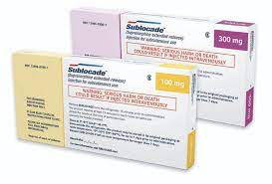
Packaging has demographics: must protect PHI
Foil package is the tamper resistant component
Notes:
SUGGESTED : Loading dose is 300 mg x 2 then 100 mg maintenance for anyone using 18 mg of buprenorphine or more daily, 300 mg x 1 then 100 mg for less than 17 mg or less
May need 300 mg maintanance

Slide 24
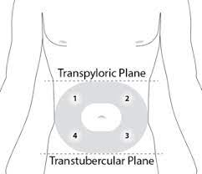

Slide 26
Notes:
Injected as a liquid and the ATRIGEL delivery system interacts with body fluids to form a mass

Slide 27
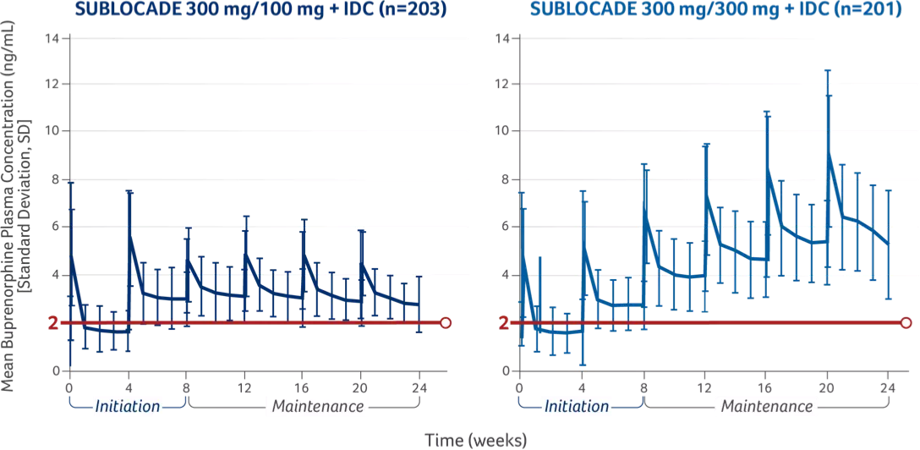
Notes:
24 weeks
2 NANOGRAMS/ML

Slide 28
Duration of action: anywhere from 42-60 days once therapeutic level is achieved
Detected in the urine for 6 months
Notes:
Opioid side effects: headache, nausea, constipation
ELEVATED liver enzymes

Slide 29
Side effects
confusion
sleepiness
blurred vision
slurred speech
Pain and infection at injection site
Cellulitis to necrosis
Notes:
Opioid side effects: headache, nausea, constipation
ELEVATED liver enzymes

Slide 30
Using Extended Release Buprenorphine Injection to Discontinue Sublingual Buprenorphine: A Case Study
Journal of Addiction Medicine

Slide 31
3 patients
Notes:
2 patients were opioid dependent
1 had a dx of opioid addiction based on episode of heroin insufflation
Weaned to low doses of buprenoprhine products 2-4 mg

Slide 32
Short Range Study
Notes:
Longest anyone was followed was 1 year
Relapse 5-10 years is possible
2 patients in my practice

Slide 33
Relapse issues:
Mental health problems
Poor coping skills
Social determinants
Notes:
But certainly, this shows promise

Slide 34
????????????????
Who is a good candidate to use Sublocade for weaning?

Slide 35
In the end, addiction is still a chronic disease. Relapse is expected.

Slide 36
Odds and Ends
Requires Secure Refrigeration
Not returnable

Slide 37
Counseling and Social Support Services as Indicated
Narcan
Notes:
Remember patients are still in recovery.

Slide 38
Quote: “I think it’s easy, and I like not having to take medicine every day.” DR

Slide 39
Quote: “I feel alright. It’s better than the pills. It’s more convenient.” TH

Slide 40
Quote: “It’s a miracle. I had no withdrawal, no fear. Life is wonderful.” KL
Notes:
Former heroin addicts, hx of bipolar, now off Sublocade of 3 months.

Slide 41
Notes:
Former heroin addicts, hx of bipolar, now off Sublocade of 3 months.

Slide 43
References:
-SAMHSA website
-American Society of Addiction Medicine 2020 Guidelines
-Indivior Sublocade Prescribing Information
-Journal of Addiction Medicine: 2021 May-June

