Slide 1
Losing Our Loved Ones:
The Opioid Epidemic and Undiagnosed Bipolar/Mental Illness

Slide 2
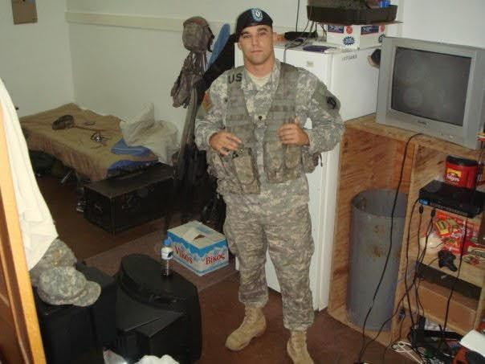
“The high from feeling accomplished is better than any other form of high”
– Mike Mansfield, 2014

Slide 3
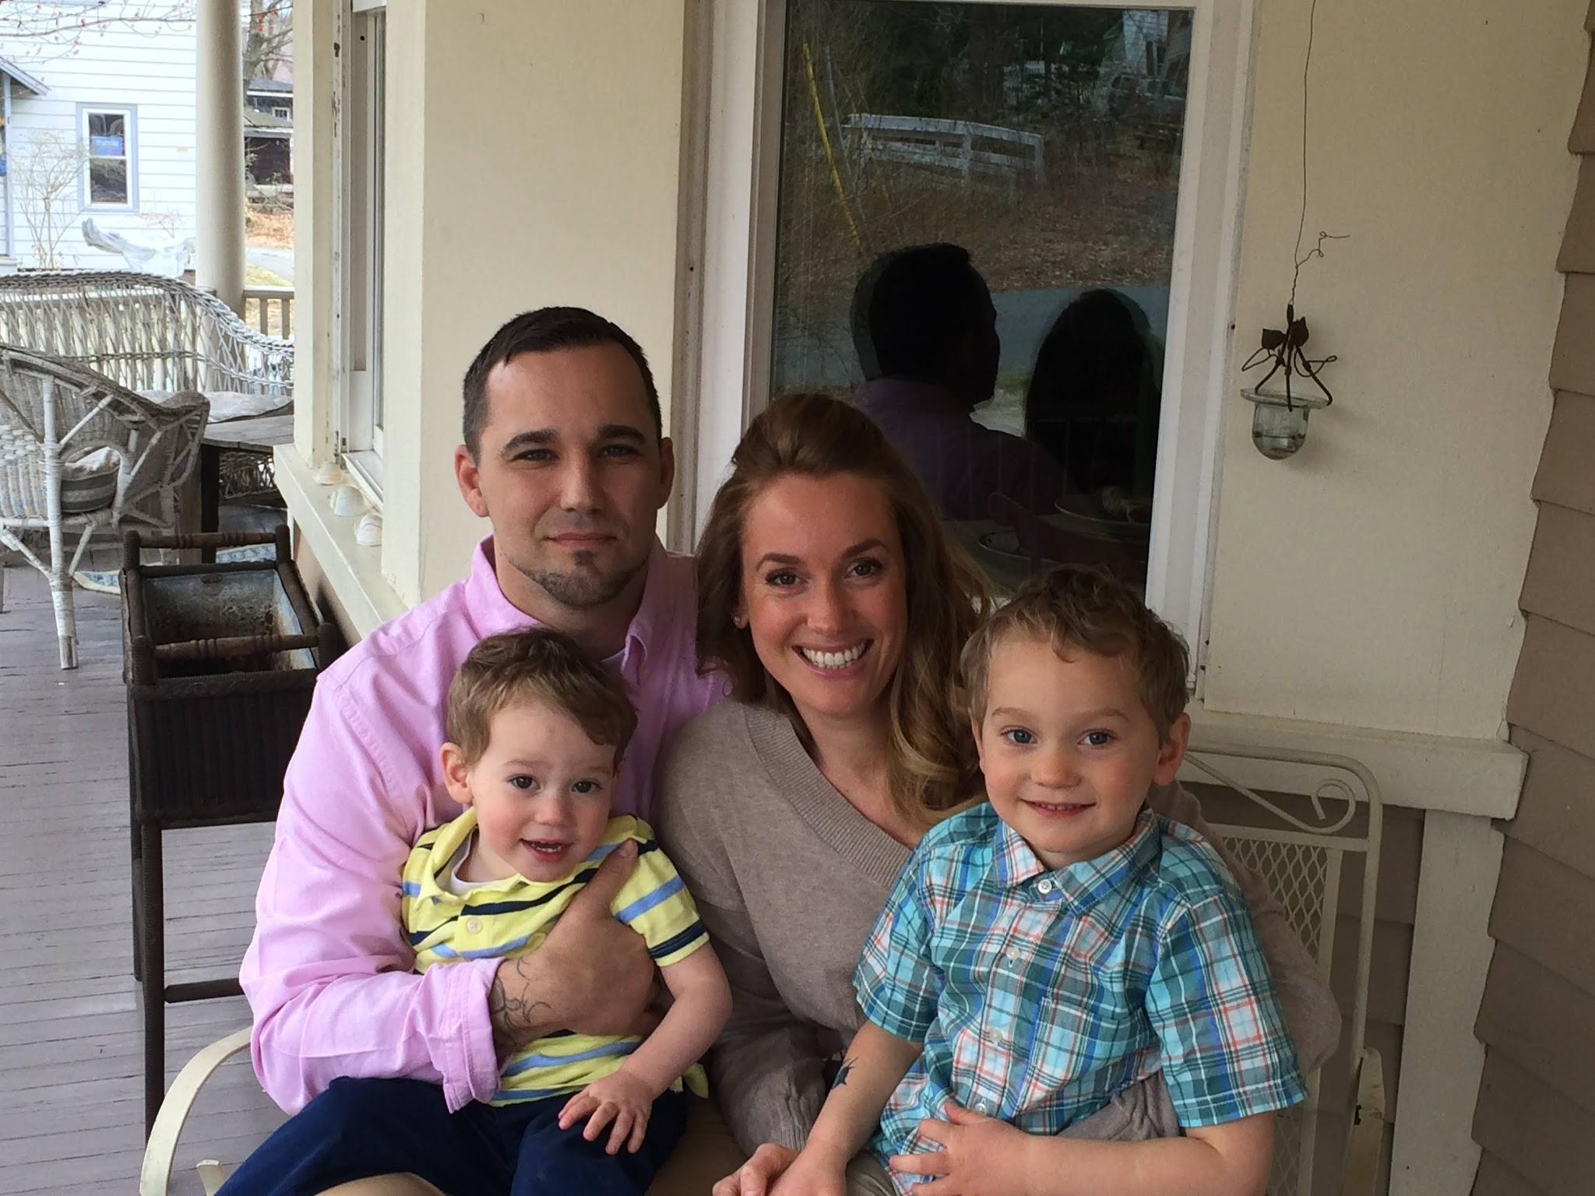

Slide 6
Learning Objectives:
Raising awareness of the link between undiagnosed mental illness and pain and addiction
Risk and impact of self medicating for those in excruciating pain
Risk factors leading to unintentional overdose for those with mental illness
End the stigma around addiction and mental health diagnoses
There is a systemic breakdown in our mental health delivery system

Slide 7
Some stats:
Opioid use disorder and opioid addiction remain at epidemic levels in the U.S. and worldwide. Three million US citizens and 16 million individuals worldwide have had or currently suffer from opioid use disorder (OUD). More than 500,000 in the United States are dependent on heroin.
– NIH, 2023
Of the 2 million US adults who misuse opioids in 2015, 62% had a mental illness. That does not reflect those with undiagnosed mental illness
– NIH, 2022
Post-traumatic stress disorder (PTSD) and addiction are strongly linked. Research suggests that almost 50 percent of people with PTSD have a co-occurring substance use disorder
–The Recovery Village, 2022
Notes:
Among the millions of adults who misused opioids in the prior year, around 40 percent had a mental illness, and around 15 percent had a serious mental illness. People regularly using opioids are twice as likely to attempt suicide compared to those who do not use them. Beyond these sobering statistics, there are compelling personal stories of people with depression, bipolar disorder, and other serious mental illnesses who find themselves locked in a cycle of drug use and despair.

Slide 8
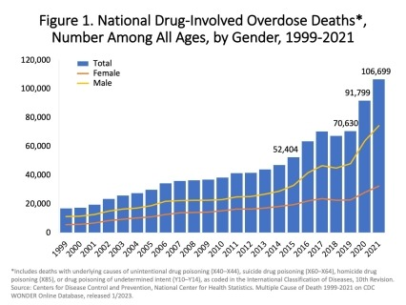
National Institute on Drug Abuse (gathered info from the CDC)

Slide 9
There is a bipolar spectrum
Image by James Phelps, MD

Slide 10
Some Bipolar Stats:
11 million Americans per year have bipolar brains
3 out of 4 of those are on the bipolar spectrum – they have depression without full mania
Suicide risk 2 times as high for people with any kind of bipolar than for those w major depression
Over 11 years on average to diagnose bipolar spectrum

Slide 11
Your EMT Toolkit
(Emergency Mental health Team)
1. Reach in
2. Listen without
judgement
3. Just do it
4. Create a posse

Slide 12
“The disease feeds on shame, shame feeds on silence and I will not be silent anymore”
Terri Cheney, Manic: A Memoir

Slide 13
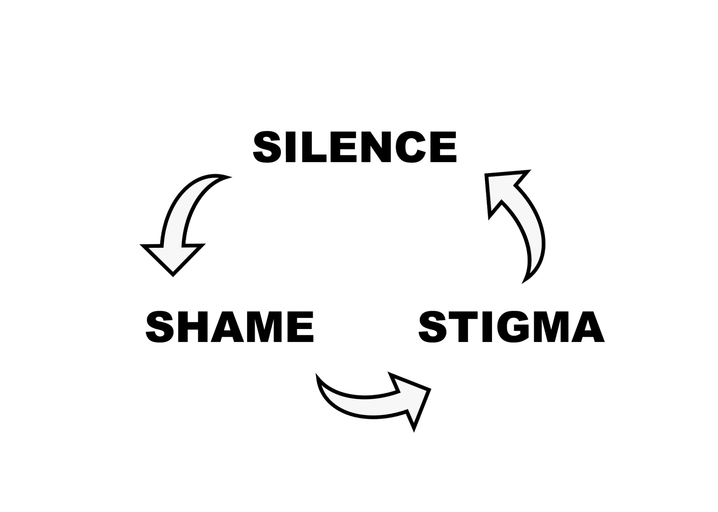

Slide 14
PECS
Notes:
PECS

